Slide 1





A General suspiciousness metric for dense blocks in multimodal data
Meng Jiang, University of Illinois at Urbana-Champaign, USA
Joint work with
Alex Beutel (CMU), Peng Cui (Tsinghua), Bryan Hooi (CMU),
Shiqiang Yang (Tsinghua), Christos Faloutsos (CMU)

Slide 2
ROADmap
1. Motivation & Problem
2. Proposed Method
3. Experiments

Slide 3
Suppose You Work in Twitter
My boss wants me to
catch fraud in such a big table – billions of records, tens of columns!!! How?!
fraud
Notes:
Big table with multiple columns. Big data with multiple modes.

Slide 4
Massive Multi-Modal Data: Lines (Mass) & Columns (Mode)
Dataset | Mode |  |  |  | Mass
Retweeting | User | Root ID | IP | Time (min) | #retweet
 | 29.5M | 19.8M | 27.8M | 56.9K | 211.7M
Trending (Hashtag) | User | Hashtag | IP | Time (min) | #tweet
 | 81.2M | 1.6M | 47.7M | 56.9K | 276.9M
Network attacks (LBNL) | Src-IP | Dest-IP | Port | Time (sec) | #packet
 | 2,345 | 2,355 | 6,055 | 3,610 | 230,836
Notes:
Big table with multiple columns. Big data with multiple modes.

Slide 5

Suspicious Behaviors in Multi-Modal Data
Notes:
Evil intention, locations, IP addresses/machines, manipulating Twitter accounts.

Slide 6


Dense Blocks Indicates Suspiciousness
200 minutes
time
225
user
27,313
Notes:
Suppose we can observe from user and time modes. We spot… For example, Real Time Deals.

Slide 7
Dense Blocks Indicates Suspiciousness
120 minutes
time
user
40
IP
12,375
2
Notes:
What if we have another mode of information, say, IP address?

Slide 8
Dense Blocks Indicates Suspiciousness
120 minutes
time
+Hashtag
+URL
+Product
+Location
+…
user
40
IP
12,375
2
Notes:
We may have more modes.

Slide 9
Dense Blocks Indicates Suspiciousness
200 minutes
120 minutes
time
time
user
225
user
40
IP
12,375
2
27,313
Question: Which is more suspicious?
We need a metric to evaluate the suspiciousness.
Notes:
Before we search, we should be able to evaluate.

Slide 10
Roadmap
1. Motivation & Problem
2. Proposed Method
3. Experiments

Slide 11
Metric Criteria
What properties are required of a good metric?
N₁ ⨉ N₂ ⨉ N₃
Count data with total “mass” C
f(
)
f(
n’₁ ⨉ n’₂ ⨉ n’₃
mass c’
density ρ’
)
n₁ ⨉ n₂ ⨉ n₃
mass c
density ρ
vs
Notes:
Suppose there is a metric function. The parameters are … size, mass, or density.

Slide 12
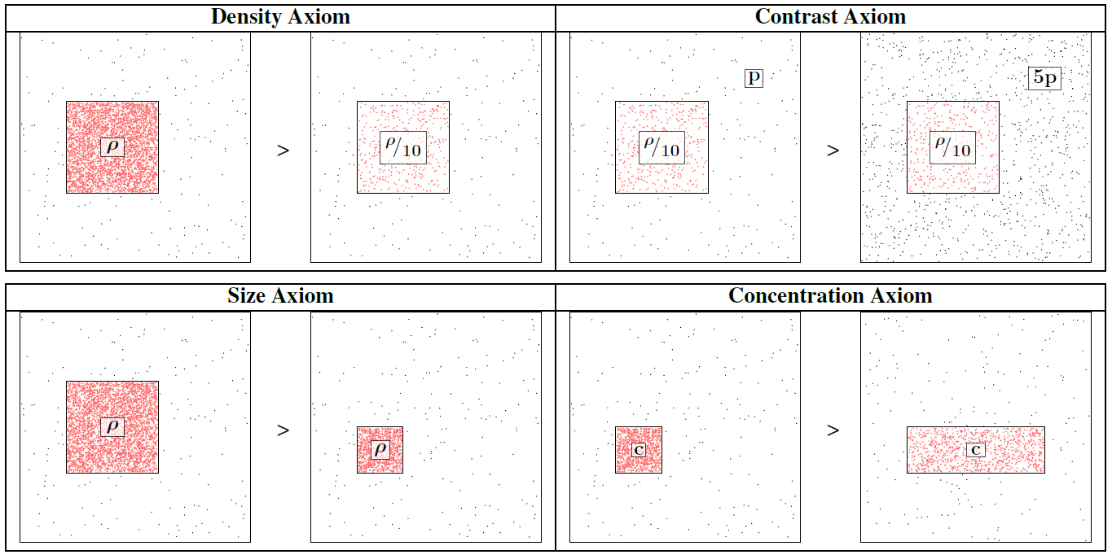
Axioms 1-4

Slide 13
Axiom 5: Multimodal
Not including a mode is the same as
including all values for that mode.
=
▶ New information (more modes) can only
make our blocks more suspicious

Slide 14
Our Principled Idea: Scoring Suspiciousness
200 minutes
120 minutes
time
time
user
225
user
40
IP
12,375
2
27,313
Probability
0.9%
0.05%
Notes:
If I told you the probability of their occurrence?

Slide 15
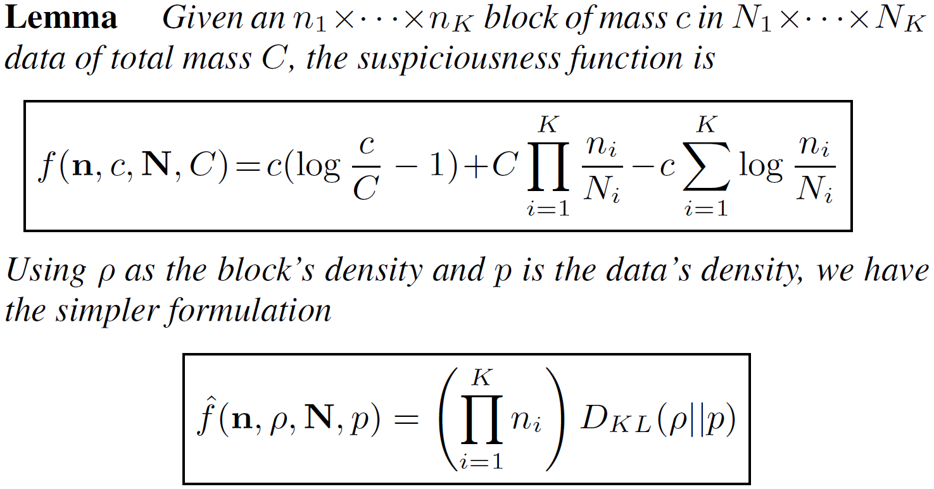
A General Suspiciousness Metric
Negative log likelihood of block’s probability
CrossSpot: Local search
Notes:
Refer to our paper for the details of our algorithm.

Slide 16
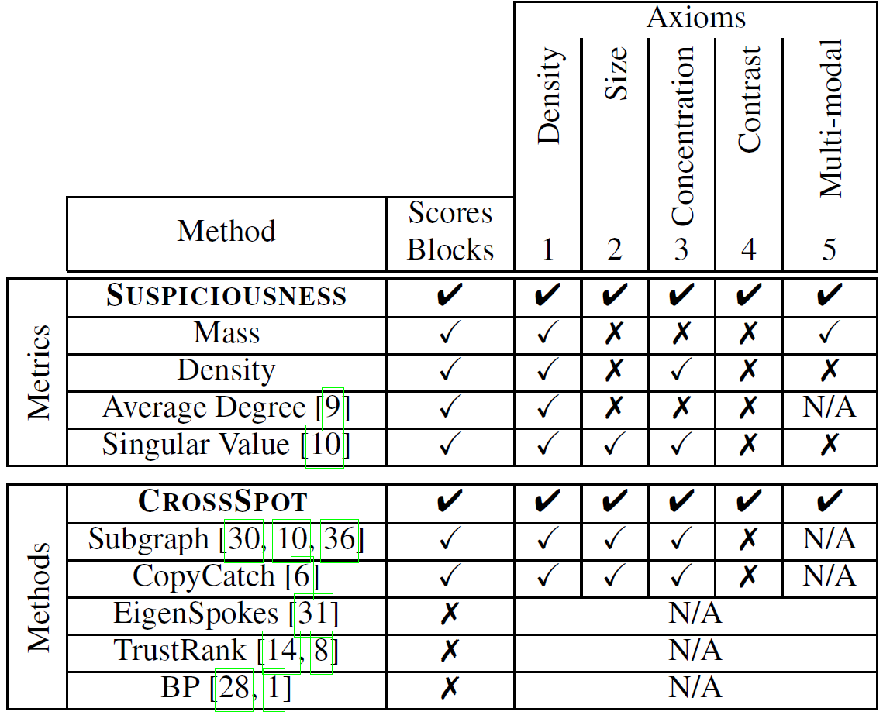
Advantage: “Suspiciousness”+CrossSpot
Scoring dense blocks
Targeting multi-modal data
Satisfying axioms

Slide 17
roadmap
1. Motivation & Problem
2. Proposed Method
3. Experiments

Slide 18
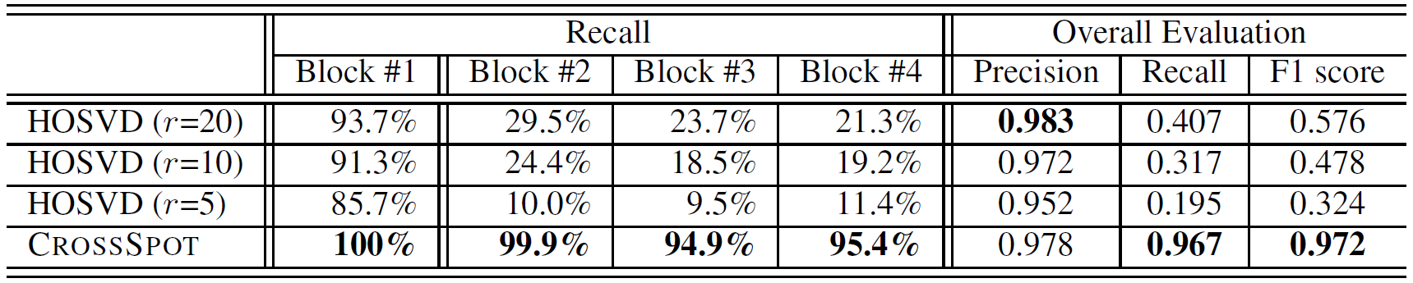
Performance: Synthetic Data
Experiments: Synthetic data
1,000×1,000×1,000 of 10,000 random data
Block#1: 30×30×30 of 512 3 modes
Block#2: 30×30×1,000 of 512 2 modes
Block#3: 30×1,000×30 of 512 2 modes
Block#4: 1,000×30×30 of 512 2 modes

Slide 19
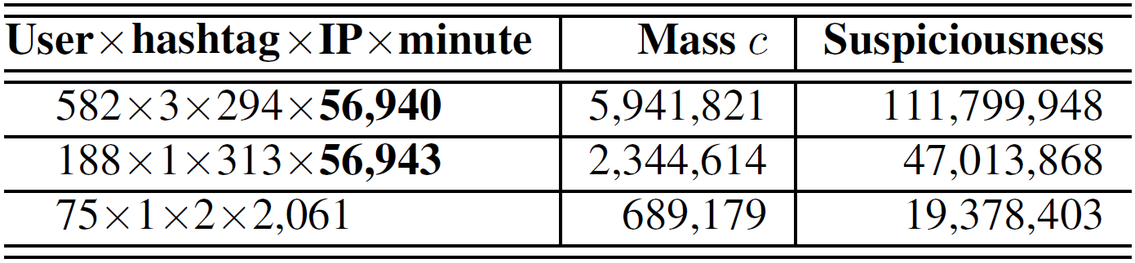
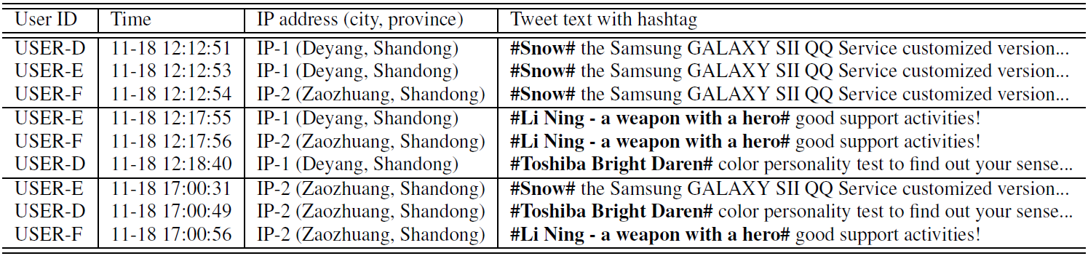
Performance: Manipulating Trends

Slide 20
Conclusion
Proposed a general “suspiciousness” metric based on probability for multi-modal behaviors
CrossSpot: Proposed a local search algorithm for catching suspicious behaviors
Thank you!
Meng Jiang, UIUC
mjiang89@gmail.com
www.meng-jiang.com

